Slide 1
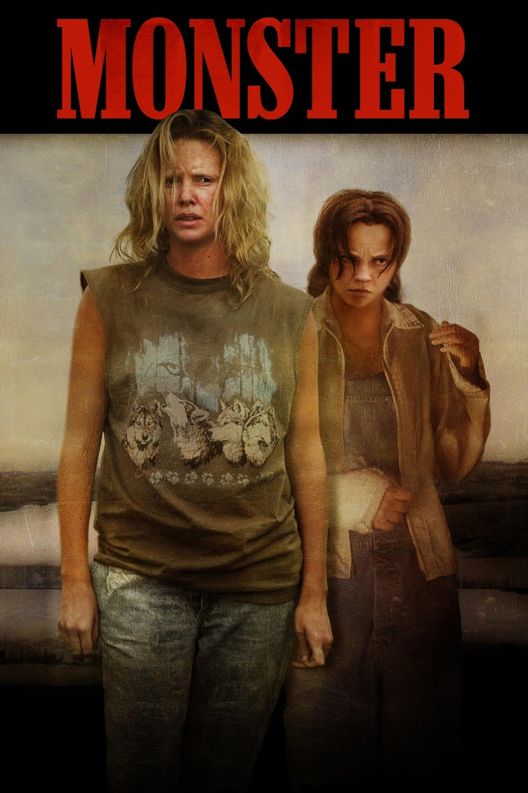
Antisocial Personality Disorder
By: Stephanie Poff, Brian Yamase,
Lulu Mendoza, & Patricia Zarate

Slide 2
According to Townsend, antisocial personality disorder is a pattern of socially irresponsible, exploitative, and guiltless behavior that reflects a general disregard for the rights of others. A person with this diagnosis tends to manipulate others for personal gain, and will be unconcerned with obeying the law. These people exhibit difficulty sustaining consistent employment and developing stable relationships. In the United States, 2-4% of men and only 1% of women display this disorder. It is most common among low socioeconomic classes, living in impoverished urban areas.

Slide 3
The movie we chose was “Monster”, a true story about Aileen Wuornos, a Daytona Beach prostitute, who becomes one of America’s first female serial killers with antisocial personality disorder. She was also diagnosed with borderline personality disorder, but for the purpose of the presentation, we will focus on the antisocial aspect only. There were many symptoms in the movie displayed by Aileen that were congruent with antisocial disorder. A few of these include:
Lee tells us in the movie she was brutally beaten and sexually abused as a child.
She is portrayed as a loner who has been unable to form or ever have a meaningful relationship,
In the movie, Lee admits to a history of felonies and is actively breaking social norms and the law by prostituting herself.
Lee, after meeting Shelby at a gay bar, decides to move Shelby into a motel with her.
Shelby tells Lee she wants to socialize and is tired of staying home, stating, “Why do you have to scare everyone away?”
Although Lee lures multiple men to their death, she continues to present herself as a victim.
Lee has frequent public displays of rage, like the one in the restaurant, after her lover, Shelby, is asked to put out her cigarette during dinner.
Lee seeks employment for a job she is unqualified for. After being turned away, she unleashes a violent tantrum in the office requiring her removal by security.
The movie suggests Lee is an alcoholic whose only social interaction, besides prostitution, is drinking at the bar.
Lee rationalizes and justifies every crime and only shows remorse at being caught.

Slide 4
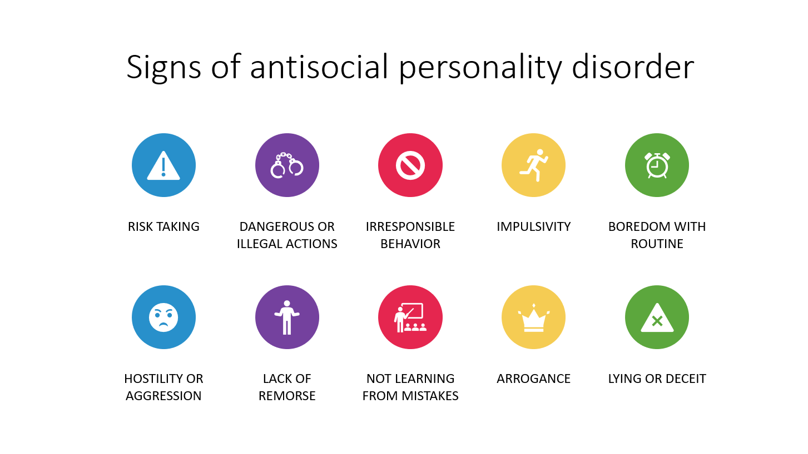
Antisocial personality disorder is often referred to as “psychopath” or a “sociopath”

Slide 5
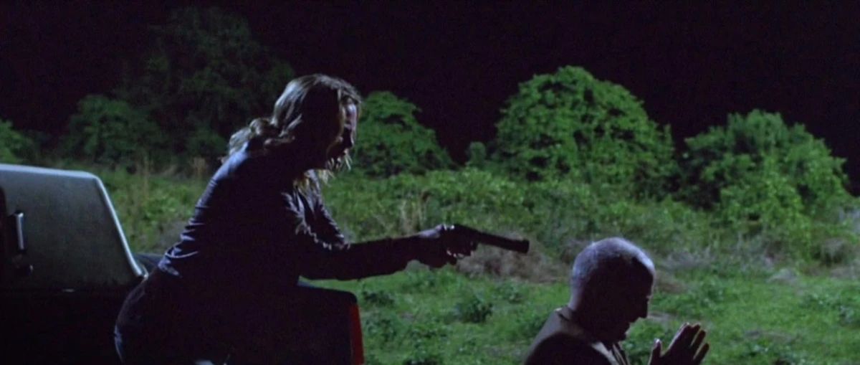
Did the movie perpetrate or ameliorate stigma related to the disorder?
The movie does a great job at showing the signs of antisocial personality disorder. However, we noticed some things that ameliorate stigma of ASPD.
  Examples:
    She hesitated to kill a few times and even crying and saying “I do not want to do this,” which is showing that she can be remorseful.
    The movie shows that she is capable of love. She is willing to do doing anything to keep Selby by her side.

Slide 6


Slide 7
Was the portrayal of ASPD in the movie congruent with your understanding of the disorder from your class text, clinical experiences and the DSM V?
Antisocial Personality Disorder: DSM V Diagnostic Criteria 301.7 (F60.2)
A. A pervasive pattern of disregard for and violation of the rights of others, occurring since age 15 years, as indicated by three (or more) of the following:
1. Failure to conform to social norms with respect to lawful behaviors, as indicated by repeatedly performing acts that are grounds for arrest.
2. Deceitfulness, as indicated by repeated lying, use of aliases, or conning others for personal profit or pleasure.
3. Impulsivity or failure to plan ahead.
4. Irritability and aggressiveness, as indicated by repeated physical fights or assaults.
5. Reckless disregard for safety of self or others.
6. Consistent irresponsibility, as indicated by repeated failure to sustain consistent work behavior or honor financial obligations.
7. Lack of remorse, as indicated by being indifferent to or rationalizing having hurt, mistreated, or stolen from another.
B. The individual is at least age 18 years.
C. There is evidence of conduct disorder with onset before age 15 years.
D. The occurrence of antisocial behavior is not exclusively during the course of schizophrenia or bipolar disorder.
Notes:
A. A pervasive pattern of disregard for and violation of the rights of others, occurring since age 15 years, as indicated by three (or more) of the following:
1. Failure to conform to social norms with respect to lawful behaviors, as indicated by repeatedly performing acts that are grounds for arrest.
Ex. In the movie, Lee admits to a history of felonies and is actively breaking social norms and the law by prostituting herself
2. Deceitfulness, as indicated by repeated lying, use of aliases, or conning others for personal profit or pleasure.
Ex. Stealing from her victims after killing them, such as taking their money, credit cards, and cars and Lying about her age, occupation, and personal history in order to gain sympathy and trust from potential victims.
3. Impulsivity or failure to plan ahead.
Ex. decision to purchase a gun impulsively, without thinking through the potential consequences or planning how she would use it. Her tendency to act on impulse when encountering potential clients, such as getting into their cars or attacking them without taking time to assess the situation.
4. Irritability and aggressiveness, as indicated by repeated physical fights or assaults.
Ex: Lee has frequent public displays of rage, like the one in the restaurant, after her lover, Shelby, is asked to put out her cigarette during dinner.
5. Reckless disregard for safety of self or others.
Ex. Lee’s tendency to become verbally and physically aggressive with those who angered her or stood in her way, such as the bartender she attacks with a pool cue in one scene and use of drugs and alcohol to cope with her emotions and alleviate her pain, despite the potential harm it may cause to herself or others
6. Consistent irresponsibility, as indicated by repeated failure to sustain consistent work behavior or honor financial obligations. Lee seeks employment for a job she is unqualified for.
Ex. After being turned away, she unleashes a violent tantrum in the office requiring her removal by security.
7. Lack of remorse, as indicated by being indifferent to or rationalizing having hurt, mistreated, or stolen from another.
Ex. Although Lee lures multiple men to their death, she continues to present herself as a victim. Lee rationalizes and justifies every crime and only shows remorse at being caught.
B. The individual is at least age 18 years. Ex. She was 33 years old
C. There is evidence of conduct disorder with onset before age 15 years.
D. The occurrence of antisocial behavior is not exclusively during the course of schizophrenia or bipolar disorder.

Slide 8
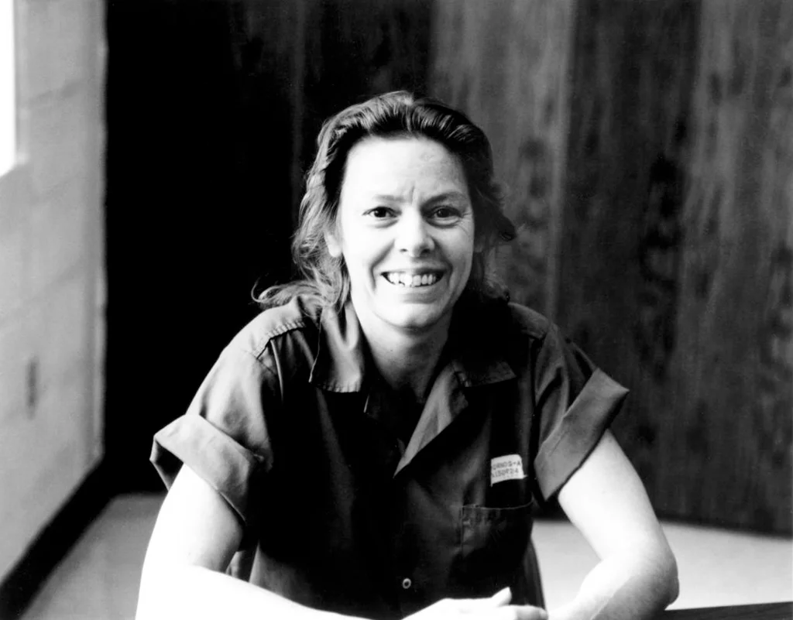
Aileen Wuornos
(1956–2002)
EVALUATION OF THE MOVIE
Overall “Monster” was useful to watch
Recommended to those who appreciate true crime movies
If recommend to clients this may be difficult for some to process especially those who have experienced trauma or abuse.
For mental health professionals or healthcare providers, the movie could be used as a starting point for discussions about trauma, personality disorders, and the intersection of mental health and criminal behavior.
Approach watching the film with an open mind and should not be used as a clinical reference or diagnostic tool.
Notes:
As a group, we thought that watching the movie was useful. “Monster" is a gripping and intense film exploring abuse, trauma, and the criminal justice system. It offers a window into the mind of a person who committed horrific acts and raises questions about the societal and personal factors that may have contributed to her actions. The film explores the psychological and emotional depths of its main character and provides a powerful commentary on the intersection of poverty, abuse, and violence. While there are certain aspects of Wuornos' behavior that are attributed to ASPD, it is a complex disorder with a range of symptoms and manifestations. Therefore, using "Monster" as a definitive depiction of the disorder would be inaccurate and unfair.
Overall, I would recommend watching "Monster" with caution, some viewers may find the film's unflinching approach to these subjects to be manipulative or unnecessary, and the intense emotional content of the film may be difficult for some viewers to handle. Additionally, the film's exploration of the psychological and emotional depths of its main character may be difficult for some clients to process, particularly those who have experienced trauma or abuse. For mental health professionals or healthcare providers, the movie could be used as a starting point for discussions about trauma, personality disorders, and the intersection of mental health and criminal behavior. "Monster" offers a portrait of a troubled individual who committed horrific acts, it is not a reliable source for understanding or diagnosing ASPD. It is important to approach the film with an open mind and recognize that it is a production of a real person's life, rather than a clinical reference or diagnostic tool. However, it's important to keep in mind that the movie is a dramatization and not an accurate portrayal of all individuals with an antisocial personality disorder or those who commit crimes.

Slide 9
References
American Psychiatric Association. (2022). Antisocial personality disorder. In Diagnostic and statistical manual of
mental disorders (5th ed., text rev.).
Fischer , K. A., & Hany, M. (2022). Antisocial Personality Disorder. National Library of Medicine: National Center for
Biotechnology Information. https://www.ncbi.nlm.nih.gov/books/NBK546673/
Townsend M. C. (2017). Essentials of psychiatric mental health nursing: concepts of care in evidenced based
Practice (7th ed.). Philadelphia: F.A., Davis.

