Slide 1
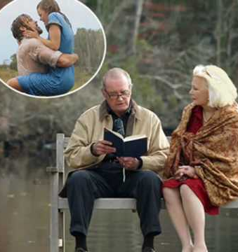
Understanding Dementia Through “The Notebook”
Group Movie Presentation created by:
Angela Angeletta
Yvonne Ballard
Jessica
Michelle
N282 1459
Professor Korey Goulette
Presented on:
11/30/2023
Mira Costa College

Slide 2
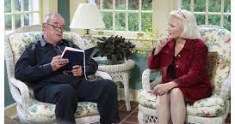
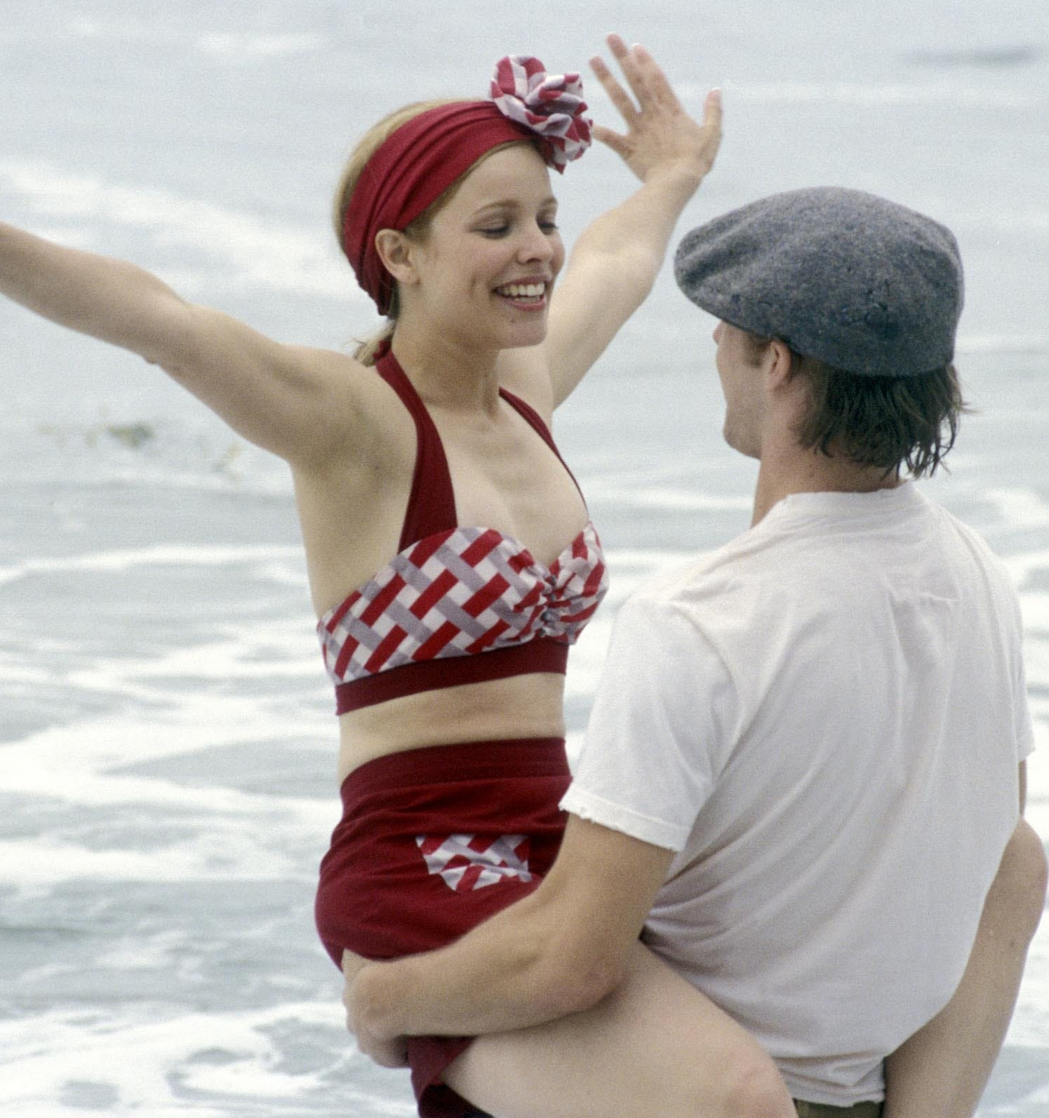

This film involves a female that develops Dementia in her older age.
She has a hard time recalling memories and identifying who certain people related to her are.
She senses good feelings around familiar people, but she can’t quite make the connection in her brain.
The male partner in the movie (Noah) reads a book of memories to her often to try and remind her of the events that took place in her life attempting to see if she may possibly recall the information hence the name of the movie “The Notebook.”

Slide 3

The Journal Allies husband Noah reads to her for memory recall includes:
Memories from the early stages of her illness, details from their romance and their life together.
Noah reads this journal with hopes she will come back to him some day, but with Demetria parts of the brain degenerate and it’s almost impossible to see someone return to their normal state.

Slide 4
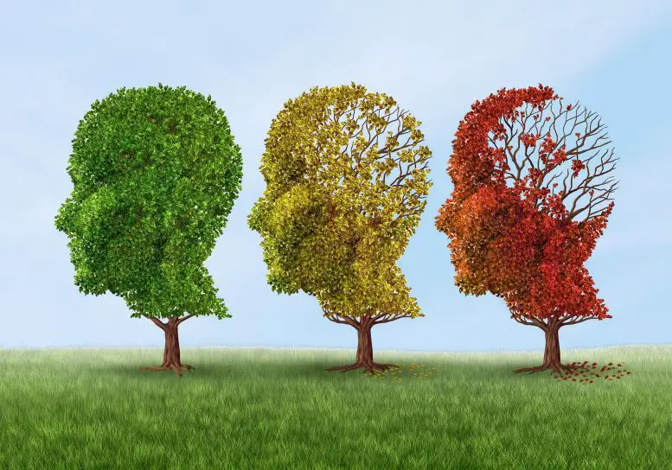
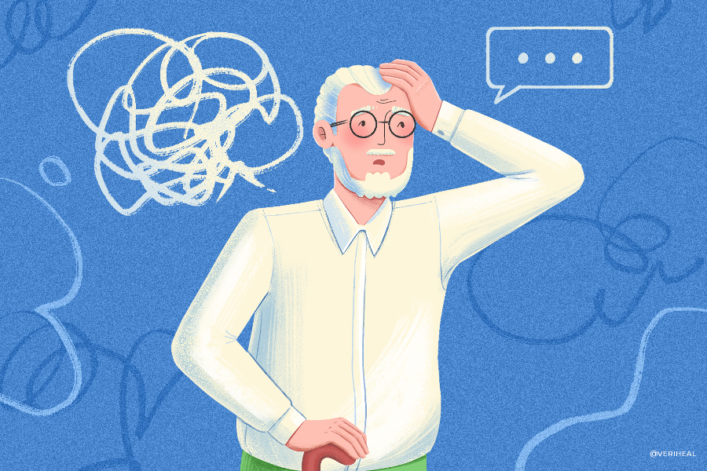
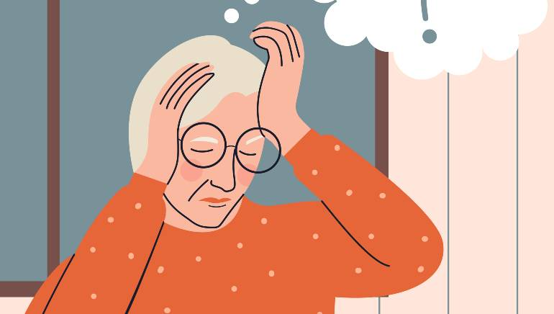
Dementia
Dementia is a general term used to describe the loss of memory, language, problem solving and other thinking abilities that are severe enough to interfere with daily life. Alzheimer's is the most common cause of dementia.

Slide 5
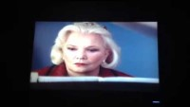
The Piano by memory

Slide 6
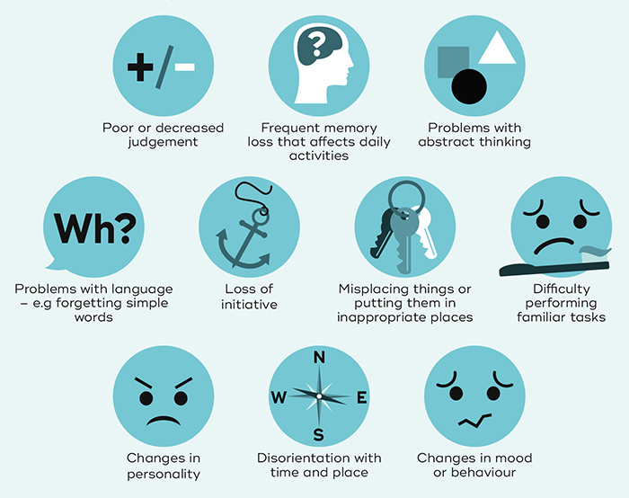
Dementia symptoms

Slide 7
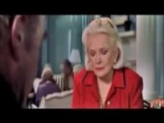
The Dementia scenes

Slide 8
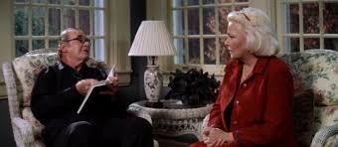
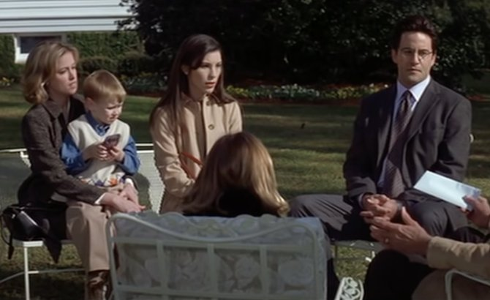
How the movie portrayed the disorder or person with the disorder
The main female character’s name is Allie. She is depicted as a vibrant and artistic woman in her youth, but as she ages, she develops Alzheimer's disease, a form of dementia.
Allie's dementia is primarily depicted through her memory loss. She is having complete memory loss of her past, including her own children and her husband. (She greeted her children and grandchildren with a polite “Nice to meet you” as if meeting them for a first time. She couldn’t recognize her husband and the events from her youth)
Allie forgetfulness is portrayed throughout the movie. Her husband read her the same story from her notebook every day, but she couldn’t recall that he did, and she was always eager to listen to the story day after day.
Allie is confused and frustrated sometime when she feels like something is familiar but cannot figure out why (She felt uncomfortable around her children and make excuses to go inside because she can sense something familiar about them but couldn’t make the connection. I think that feeling scared her)
Allie needs assistance with ADLs and frequent reorientation. (the nurse reminds her of the time to rest and time for meals or time to play the piano)
Study shows that in patient with dementia, procedure memories can remain intact and can be retrieved without conscious awareness (Allie still can play a piano and perform a piece of music from her memory)

Slide 9
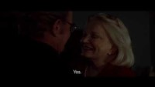
Allie Remembers/ Forgets/Triggered/Outcome
Notes:
Recap: In the poignant scene above, Noah arranged a special dinner with the help of the staff. During dinner, when the song from their youth was played, there was a brief moment when Allie recognized Noah, but her memory quickly lapse. She couldn’t master the situation cognitively: she got confused, scared, and started yelling, calling her husband and imposter. The interaction led to the use of medication management and a take down by the staff.

Slide 10
Did the movie perpetrate or ameliorate stigma related to the disorder? How?
The film both perpetrate and ameliorate stigma related to dementia.
The movie perpetuates certain stigma about dementia by presenting a romanticized and idealized view of the condition. The focus on the enduring power of love may downplay the harsh realities and challenges faced by individuals with dementia and their caregivers. The film does not fully capture the complexities of dementia, leading to a simplistic and sentimentalized portrayal that does not reflect the diversity of experiences associated with the condition. (The film only focuses on memory loss; it doesn’t touch on other aspects of dementia, such as loss of motor skills and mobility, cognitive function, language, and communication, etc.)
The film ameliorate stigma. the film humanizes individuals with dementia by showing the impact of the disease on a personal level. It portrays Noah's dedication and commitment to Allie, emphasizing the emotional connection that persists despite the challenges posed by dementia. By highlighting the theme of enduring love, the movie may contribute to fostering empathy and understanding for those affected by dementia

Slide 11

Class Text vs. The Movie
The description of dementia in the movie, portrayed through the character of Allie, is about 20% congruent with the description in the textbook "Essentials of Psychiatric Nursing 10th Edition"
In the textbook, cognitive impairment is always associated with dementia. Cognitive impairment includes forgetfulness, repetitive conversation, and losing track of a conversation. Allie only displays the loss of short-term and long-term memories. She doesn't show repetitive conversation or loss of track of a conversation.
In addition to memory loss, Allie also shows signs of apathy and withdrawal from normal activities. For example, at the beginning of the movie, Allie didn't want to leave her room for the day and sometimes appeared to be in a depressive mood. This manifestation is congruent with the textbook.
Notes:
(She followed the story that Noah read to her. She also kept asking him, "What's next? What happened to Allie? What happened to them?"). When a person has already lost both short-term and long-term memories, their dementia is in an advanced stage, and it's impossible for them to stay focused or have the mental capacity to follow a conversation or a story. However, in the movie, Allie did. This portrayal is quite unrealistic and not congruent with the textbook.

Slide 12
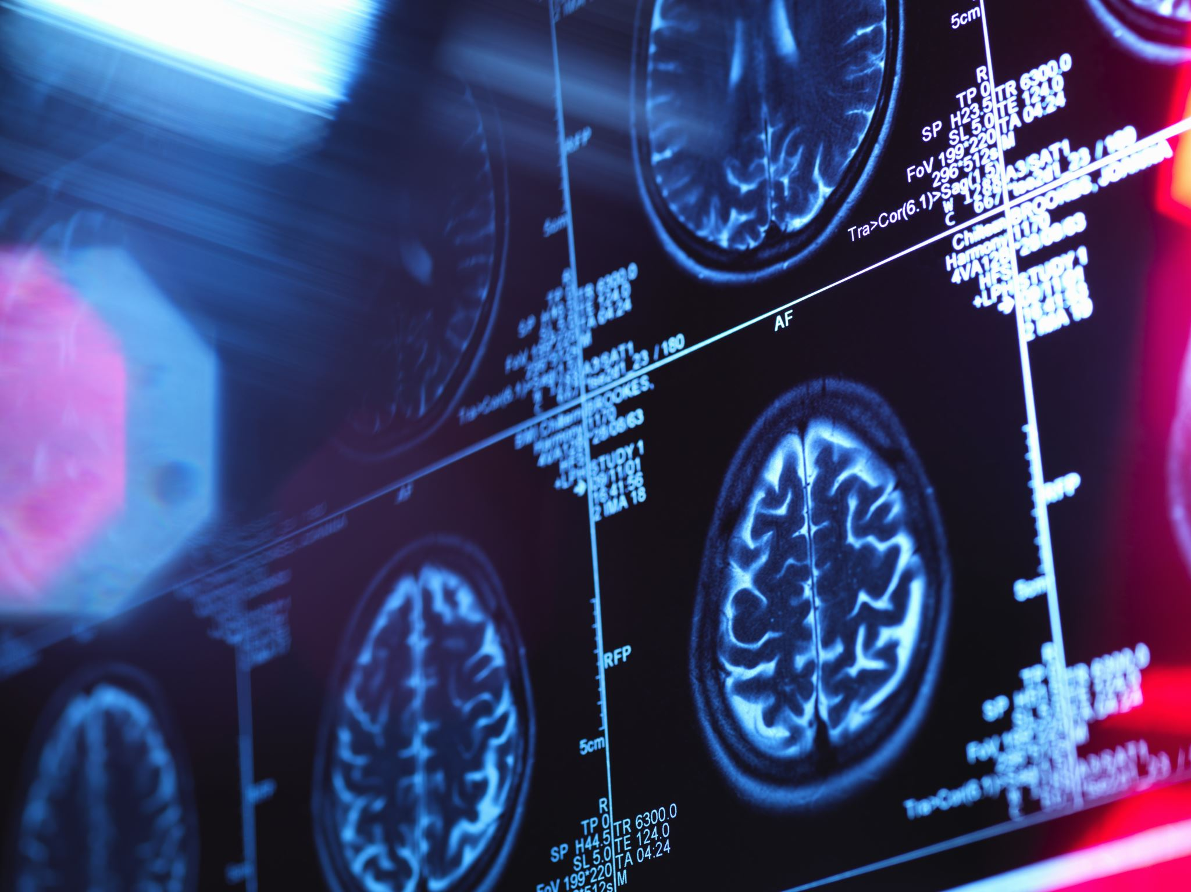
DSM-5 provides specific criteria for the diagnosis of major neurocognitive disorders, which include various types of dementia.
To receive a diagnosis of dementia, an individual must exhibit significant cognitive decline from a previous level of functioning that interferes with daily life. This decline should be evident in at least one cognitive domain, such as memory or executive function. Further, the cognitive deficits must not occur exclusively in the context of a delirium or be better explained by another mental disorder.

Slide 13
Evaluation and Recomendation
"The Notebook" is a beautiful movie about love and enduring commitment, even in the face of dementia. It is recommended for families and caregivers dealing with dementia, offering relatable insights into the emotional aspects of caregiving. Its portrayal of enduring love and commitment can facilitate meaningful discussions within families. However, it is not recommended for healthcare providers in geriatrics or dementia care, as it may lack the clinical depth needed for a comprehensive understanding of dementia symptoms and caregiving challenges. Healthcare professionals might find more value in resources that provide a realistic and detailed depiction of the complexities associated with dementia.

Slide 14
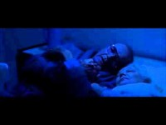
25-58sec

Slide 15
References:
Angeletta,A., Ballard,Y., (2018, September 20). Introduction to classics [PowerPoint slides]. Faculty of Classics,
Oxford University. https://login.canvas.ox.ac.uk/
Boyd, M. A., & Lubbert, R. (2023). Essentials of Psychiatric Nursing (3rd ed., pp. 568-583). LWW.
Cassavetes, N. (2004). The Notebook. New Line Cinema.
American Psychiatric Association. (2022). Diagnostic and statistical manual of mental disorders (5th ed., text
rev.). https://doi.org/10.1176/appi.books.9780890425787
Boyd, M. A., & Luebbert, R. (2023). Chapter 31: Mental health disorders of older adults. In Essentials of Psychiatric
Nursing (pp. 87-92). Wolters Kluwer.
Hugo, J., & Ganguli, M. (2014). Dementia and cognitive impairment: Epidemiology, diagnosis, and treatment.
Clin Geriatr Med, 30(3), 421-442. https://doi.org/10.1016/j.cger.2014.04.001
Kawai, H., Kawamura, M., Mochizuki, S., Yamanaka, K., Arakaki, H., Tanaka, K., & Kawachi, J. (2002).
Longitudinal study of procedural memory in patients with Alzheimer-type dementia. No To Shinkei, 54(4), 307-311. https://www.ncbi.nlm.nih.gov/pubmed/11993158

